Slide 1
Bear ‘n Bull
Created by
Error_404

Slide 2
Abstract
Stock Market Trend Prediction using an Automated News Analysis Description of Problem / Scenario The sentiment of share market and investment largely depends on the news. Through this project, relationship between news and stock trend is depicted. This project is about taking non quantifiable data such as financial news articles about a company and predicting its future stock trend. Stock Market based on stock exchange that’s require information security. Our product will monitor stock exchange through Blockchain. Each transaction will be stored in Blockchain.
The system will give some prediction and information security in one plate. The systems will be able to read the news feed from popular news sources and run an analytical algorithm to understand the sentiment about a particular stock or a segment. The insights and predictions will be generated in portable GUI formats. Non-functional (Qualitative) features of project
The user interface will be intuitive and easy to use.
Response communication will be in real-time.
The system will be flexible to tune and use multiple algorithms for comparison of results

Slide 3
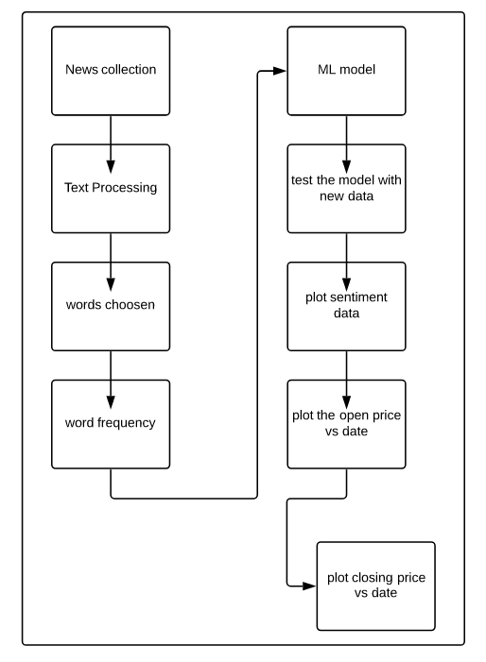
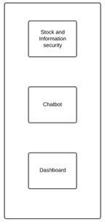

Flow Diagram

Slide 4
Module Wise Deployment
Requirement analysis and use case (newspaper library)
Sentiment analysis
ML implementation (liner and logistic regression)
Dashboard
Chatbot
Front end development
Blockchain for stock and information security

Slide 5
Technology Stack
Languages:
  Python
  JS
  HTML
  CSS
Scraping library - Newspaper3k7
IBM Watson Assistant- Xc
IBM Cognos Analytics
Machine Learning Algorithms like Logistic Regression & Linear Regression
Google APIs for integrating Chart and graphs on the webpage
Flask
BlockChain

Slide 6
Information about IBM Cognos
IBM Cognos Business Intelligence is a web-based integrated business intelligence suite by IBM.
It provides a toolset for reporting, analytics, score carding, and monitoring of events and metrics.
The software consists of several components designed to meet the different information requirements in a company.
IBM Cognos provides a wide range of features and can be considered as an enterprise software to provide flexible reporting environment and can be used for large and medium enterprises. It meets the needs of Power Users, Analysts, Business Managers and Company Executives.
Power users and analysts want to create ad-hoc reports and can create multiple views of the same data. Business Executives want to see summarize data in dashboard styles, cross tabs and visualizations. Cognos allows both the options for all set of users.

Slide 7
Information About IBM Watson
Watson is a question-answering computer system capable of answering questions posed in natural language,[2] developed in IBM's DeepQA project by a research team led by principal investigator David Ferrucci. Watson was named after IBM's founder and first CEO, industrialist Thomas J. Watson.
The computer system was initially developed to answer questions on the quiz show Jeopardy! and, in 2011, the Watson computer system competed on Jeopardy! against champions Brad Rutter and Ken Jennings, winning the first place prize of $1 million.
In February 2013, IBM announced that Watson software system's first commercial application would be for utilization management decisions in lung cancer treatment at Memorial Sloan Kettering Cancer Center, New York City, in conjunction with WellPoint (now Anthem). Manoj Saxena, IBM Watson's then business chief, said in 2013 that 90% of nurses in the field who use Watson now follow its guidance.

Slide 8
What is actually a blockchain?
Blockchain is a distributed, shared and immutable digital ledger that keeps a record of all transactions that take place across a peer-to-peer network.
It is a decentralised (stored in multiple places) record of transactions, also known as a ledger
Transactions are bundled together into a data block, which undergoes encryption, resulting in a unique signature for each block known as a hash.
These blocks are then ordered sequentially into a chain of blocks, with each block containing the previous block’s hash, making it tamper proof
The blocks are immutable, as altering a single piece of data would result in a different hash value, making the change evident to the blockchain’s users and resulting in the transaction being rejected.

Slide 9
What blockchain provides
Decentralisation
Peer-to-Peer Network
Immutability
Tamper-Proof

Slide 10
The following features make the revolutionary technology of blockchain stand out:
Decentralised
Blockchains are decentralized in nature meaning that no single person or group holds the authority of the overall network. While everybody in the network has the copy of the distributed ledger with them, no one can modify it on his or her own. This unique feature of blockchain allows transparency and security while giving power to the users.
Peer-to-Peer Network
With the use of Blockchain, the interaction between two parties through a peer-to-peer model is easily accomplished without the requirement of any third party. Blockchain uses P2P protocol which allows all the network participants to hold an identical copy of transactions, enabling approval through a machine consensus. For example, if you wish to make any transaction from one part of the world to another, you can do that with blockchain all by yourself within a few seconds. Moreover, any interruptions or extra charges will not be deducted in the transfer.
Immutable
The immutability property of a blockchain refers to the fact that any data once written on the blockchain cannot be changed. To understand immutability, consider sending email as an example. Once you send an email to a bunch of people, you cannot take it back. In order to find a way around, you’ll have to ask all the recipients to delete your email which is pretty tedious. This is how immutability works.
Once the data has been processed, it cannot be altered or changed. In case of the blockchain, if you try to change the data of one block, you’ll have to change the entire blockchain following it as each block stores the hash of its preceding block. Change in one hash will lead to change in all the following hashes. It is extremely complicated for someone to change all the hashes as it requires a lot of computational power to do so. Hence, the data stored in a blockchain is non-susceptible to alterations or hacker attacks due to immutability.
Tamper-Proof
With the property of immutability embedded in blockchains, it becomes easier to detect tampering of any data. Blockchains are considered tamper-proof as any change in even one single block can be detected and addressed smoothly. There are two key ways of detecting tampering namely, hashes and blocks.
As described earlier, each hash function associated with a block is unique. You can consider it like a fingerprint of a block. Any change in the data will lead to a change in the hash function. Since the hash function of one block is linked to next block, in order for a hacker to make any changes, he/she will have to change hashes of all the blocks after that block which is quite difficult to do.

Slide 11
Achievements
Dynamic data is used, scraped by newspaper3k library
Sentiment analysis is done to generate the frequency of positive and negative words and null data, incompetent data is removed.
Dynamic dashboard for multiple companies is created using IBM Cognos
Real time chatbot is used to help the end user(s) to help getting information about the marketing world.
The machine learning algorithm uses Logistic regression and linear regression (multiple algorithm implementation on the same data) to predict the stock price for the next date
Real time Information security of login and transactions are handled using Blockchain technology

Slide 12
THANKYOU

